Slide 1
23RD JANUARY 2019 Version 1.0
INTELLIGENT AUTOMATION
RPA ARCHITECTURE – TRANSITION TO AWS

Slide 2
INTRODUCTION
Since September’18, SLC has been engaged with the mobilisation and implementation of Robotics Process Automation across several areas of SLC
UiPath is the current RPA software which is being trialled to April 2019
An initial Development and Production architecture was established utilising on-premise, physical desktops to support automation running
As SLC looks to scale RPA ahead of peak, in June'19, it is recommended that SLC explore the exploitation of Cloud Capability to benefit from flexible capacity
The following deck provides an overview of the existing RPA architecture to support discussions on the utilisation of Amazon Web Services (AWS) for a future RPA architecture

Slide 3
SESSION OBJECTIVES
Gain a common understanding of RPA Automation
Agree the Development Pipeline for automation
RPA in the Cloud
Cloud Requirements
Connectivity Requirements / Access to SLC Services – design at the edge of SLCs Network
Active Directory Integration / Security Tooling
Software Stack / DevOps
Resilience Options – e.g. Multiple AZ’s, SQL Server Always On
Agree Next Steps and Indicative Timelines

Slide 4
1. GAIN A COMMON UNDERSTANDING OF RPA AUTOMATION

Slide 5

RPA AND UiPath
Types of Automation:
Attended
Robot steps in to assist human
Useful in circumstances where decisions require humans and/or there are too many process variations to allow tactical process automation
Unattended
Robots run in batch mode processing tasks pushed to them from e.g. a workflow system
Example Scope of Automation:
Windows applications
Web applications (IE, Chrome, Firefox)
Citrix-based applications (or other remote desktop solutions)
Web services
Spreadsheets
Consists of:
Studio – interactive process design tool
Robot – standalone runtime to run a single process
Orchestrator – web-based Robot Operations console
RPA Developers develop processes and push them to Orchestrator
Robotics Operations Centre use Orchestrator to allocate robot resources to processes
Reporting
Elasticsearch / Kibana-based dashboarding

Slide 6
RPA AND UiPath
Automations Built to Date;
View Course Changes (VCC)
Automation driven from Excel Files
Utilises LA Portal to perform Assessments
Logs files stored on local machine (in text format)
Manual Excel Dashboard
Sponsor Financial Tasks (SPFT)
Automation driven from OPX
Utilises LA Portal to perform Assessments
Logs files stored on local machine (in text format)
Manual Excel Dashboard
LA Portal Password Reset (PWR-LAP)
Automation driven from Assyst
Utilises LA Portal to perform password reset
Utilises Lotus Notes to send email
Logs files stored on local machine (in text format)
Manual Excel Dashboard
Pipeline Automations;
CLASS Password Reset
Loan Sale Reconciliation
Optical Character Recognition (OCR)
AI/Machine Learning
Chat Bots

Slide 7
2. AGREE THE DEVELOPMENT PIPELINE FOR AUTOMATION

Slide 8
DEVELOPMENT PIPELINE
The current DevOps pipeline is as follows:
UiPath Studio
GitLab
UiPath
Robot
Automations (Robots) are built using UiPath Studio held on local dev machines (physical desktops)
Testing undertaken on Next Test
UiPath Source code is pushed onto the GitLab code respository
UiPath Source code is pulled down from GitLab and stored on the local C drive of the Production machine (physical desktop)

Slide 9
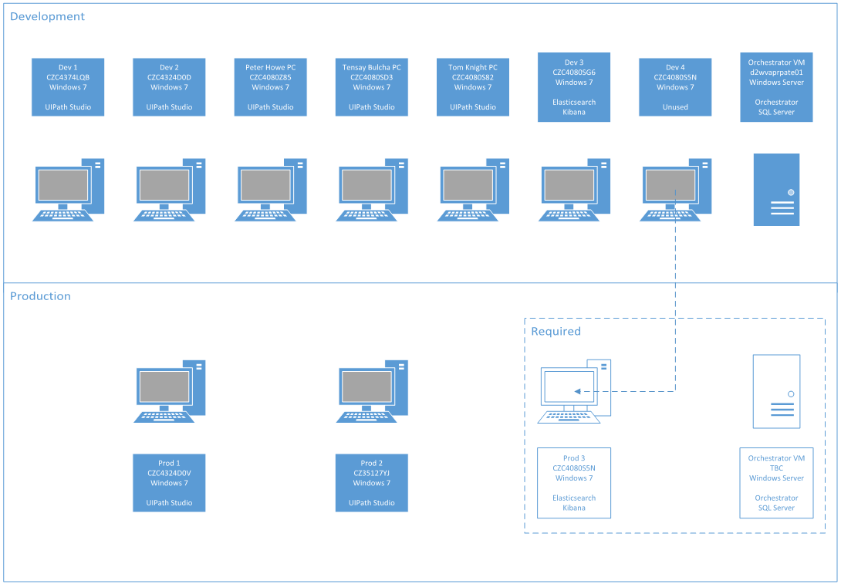
CURRENT RPA ARCHITECTURE
Current Architecture
Currently for RPA development we are using 5 development machines which are broken down to:
2 remote access machines
3 physical desktop machines
We have 2 new desktops which we are currently installing ElasticSearch and Kibana (EK)
We also have an Orchestrator VM which is provisioning studio licenses for some of our dev machines
Publishing tested
Queue creation tested
Our “production” environment consists of 2 production machines
One of the boxes which we have provisioned with EK will need to be moved to our Prod environment
We still need one more box for our Production Orchestrator

Slide 10
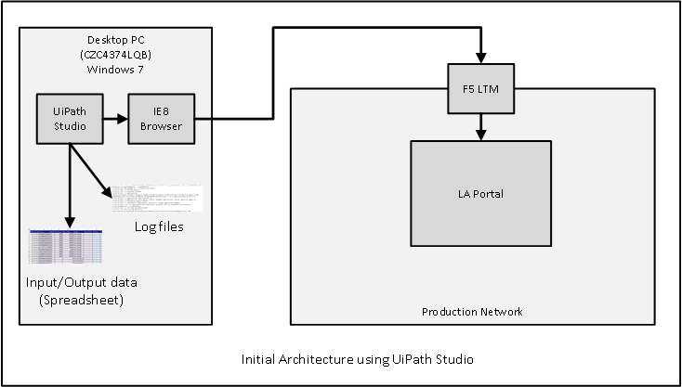
EXAMPLE – VCC PROCESS ARCHITECTURE

Slide 11
DEVELOPMENT PIPELINE
The Proposed DevOps pipeline is as follows:
UiPath Studio
UiPath Orchestrator
UiPath
Robot
Automations (Robots) are built using UiPath Studio
Testing undertaken on Next Test
UiPath Source code is automatically pushed to the UiPath Robot deployed on a specific machine
UiPath Source code is published from UiPath Studio to Orchestrator which assigns the required version control
Source code will also be stored within GitLab

Slide 12
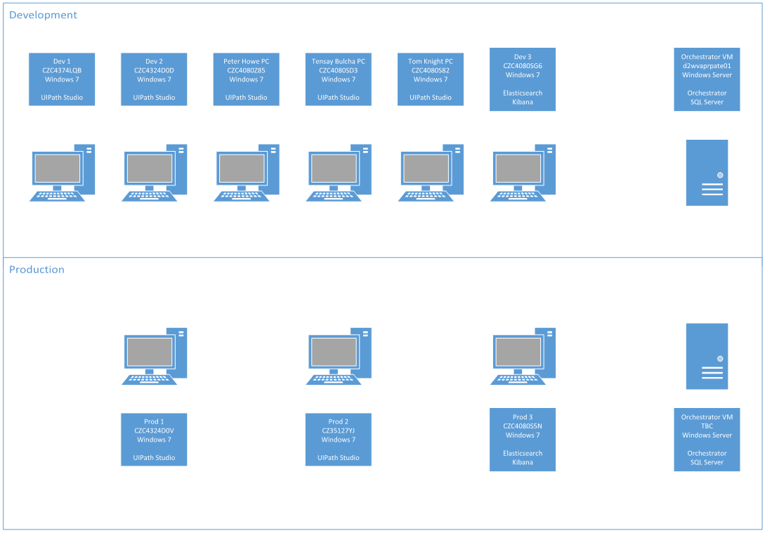
INTERIM PHYSICAL ARCHITECTURE (TBC)
Interim Model
A possible interim step would be to deploy robots and orchestrator on premise using a development-production pipeline
Utilise the 6 studio development licenses for our dev machines
Our EK machines will be split between our development environment and our production environment
We would have a dev Orchestrator which developers would use to test queues and the running of process as “robots”
Developers would push this code to the Prod Orchestrator and schedule the robots as agreed

Slide 13
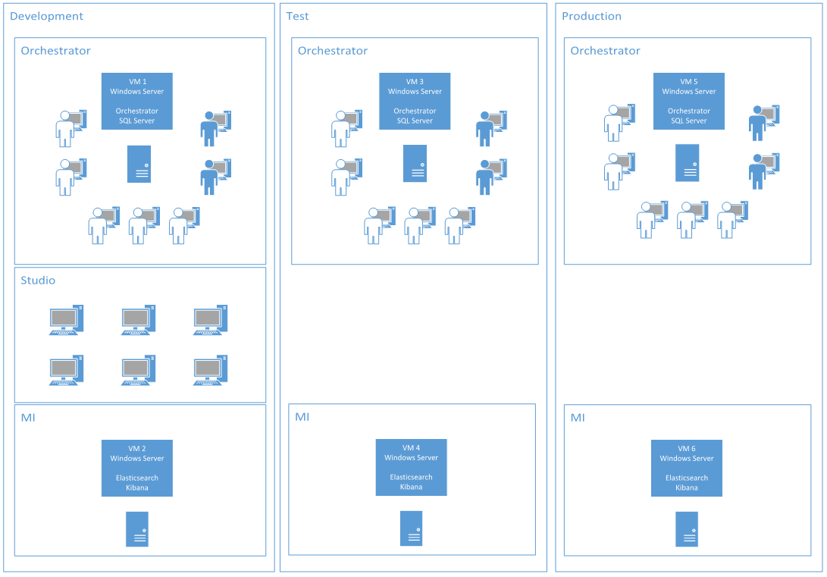
OPTION 1 – SEPERATE ORCHESTRATOR INSTANCES
Separating Dev, Test and Prod
This provides a seamless pipeline transition from dev to prod
All three instances will be separated from each other
Developers promote code to Test to run robots, prove scheduling and queues before deployment into the live environment
However, to maximise benefit we require Test environments which are stable and near to our live environment
Test environments which are too dissimilar to Live will cause code fixes to be made in test which would not be maintained in live

Slide 14
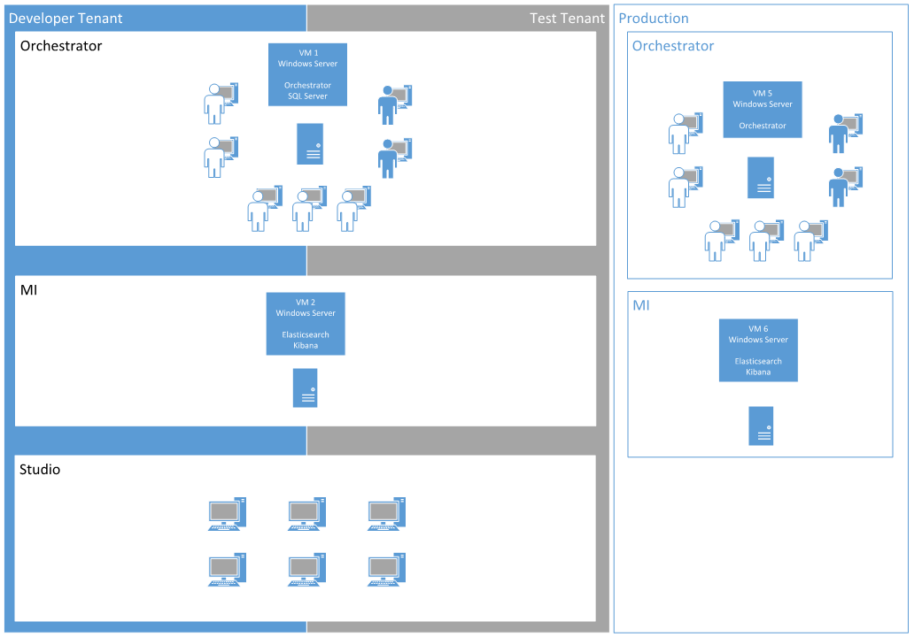
OPTION 2 – MULTITENANT ORCHESTRATOR
Dev and Test Tenants
Multitenancy allows us to use one Orchestrator for our Dev and Test environments
This hybrid model allows us to isolate data between the two tenants
Developers will build their code and decide whether to publish to a Dev Tenant or a Test Tenant
The seats under this licensed Orchestrator would be shared among the 2 tenants
5 unattended
2 attended
6 studio
The nature of seat switching between tenants would greatly impact the viability of this model

Slide 15
3. RPA IN THE CLOUD

Slide 16
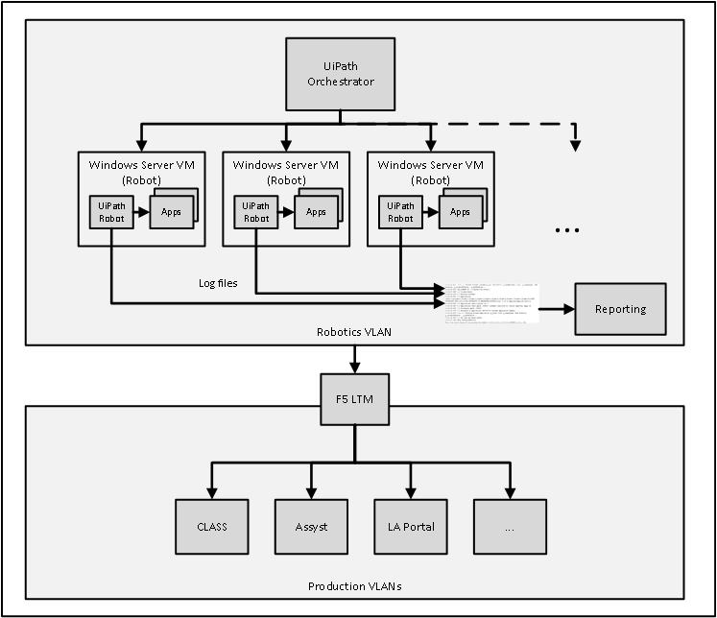
1. CLOUD REQUIREMENTS
Target Architecture (approximate)
Run RPA Automations with the flexibility and scalability of the cloud
Execute the following Automation Software stack from the Cloud
UiPath Orchestrator
UiPath Robot
ElasticSearch
Kibana
TBC – Will Development (UiPath Studio) be undertaken on a Dev Environment in the cloud
How will test environments be connected to?

Slide 17
2. CONNECTIVITY REQUIREMENTS / SLC ACCESS
AWS to SLC
Robot VMs -> SLC Services (Prod and Non-Prod)
Studio VDI -> SLC Services (Non-Prod) for UI interaction capture, GitLab, etc.
SLC to AWS
ROC -> Production Orchestrator Web UI
“BAU” to Non-Prod Orchestrator Web UI
DBA -> SQL Server / SQL Server Management Studio
“BAU” network to Kibana for dashboards
“BAU” to VDI for UiPath Studio
AWS to AWS
Studio VDI VMs to Non-Prod Orchestrator (licensing, deployment)
Example Services Requiring Connectivity
LA PORTAL
OPX
ASSYST
LOTUS NOTES
MS EXCEL
CLASS

Slide 18
3. ACTIVE DIRECTORY INTEGRATION / SECURITY TOOLING
A/V, EMMS
Access for automation developers
Audit

Slide 19
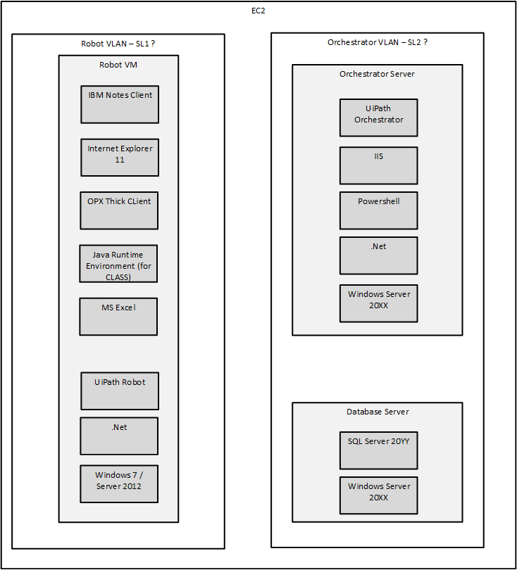
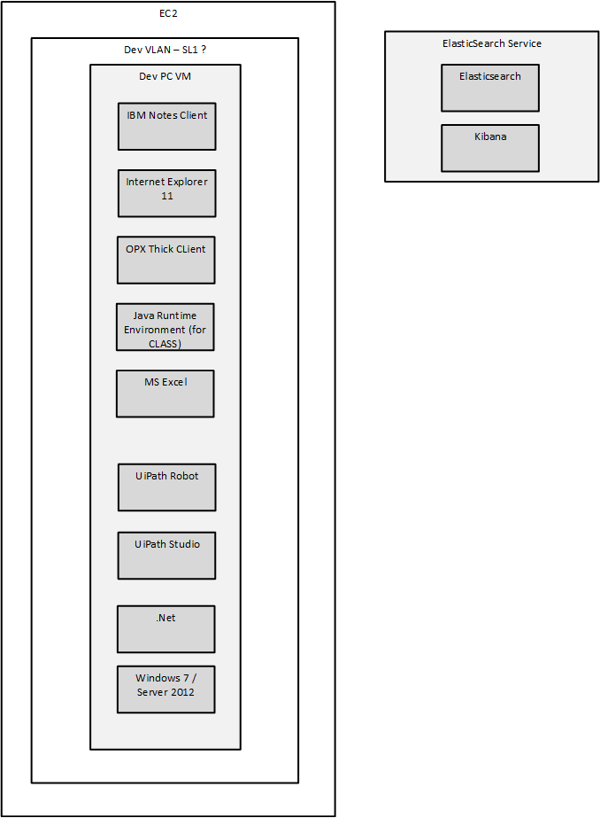
4. SOFTWARE STACK / DEVOPS
Use of DevOps practices on Windows to provision VM

Slide 20
5. RESILIENCE OPTIONS
What happens if Orchestrator VM is down?

Slide 21
3. AGREE NEXT STEPS AND INDICATIVE TIMELINES

